Slide 1
Ball Maze
By Alex Blake & Jameson Shaw

Slide 2
Goals
Acceleration
Wall Collision
Controlled by Accelerometer
Timer / Other UI

Slide 3
Results
Working:
Acceleration of Ball
Wall collisions (mostly)
SPI Controller (Accelerometer)
Not Implemented:
Win condition
UI (timer / game info)

Slide 4
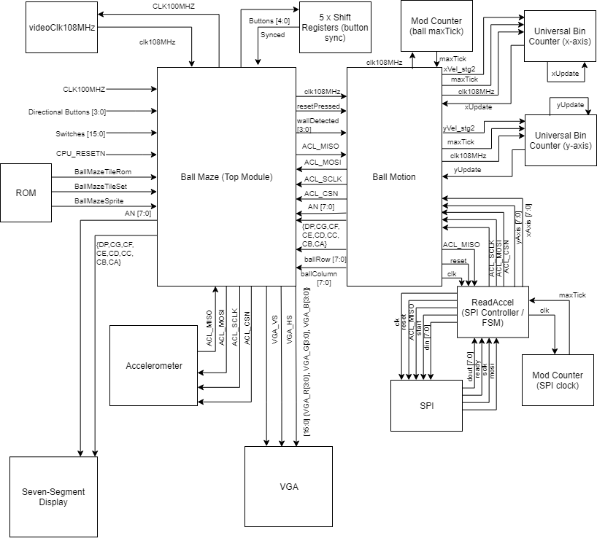
Block Diagram

Slide 5
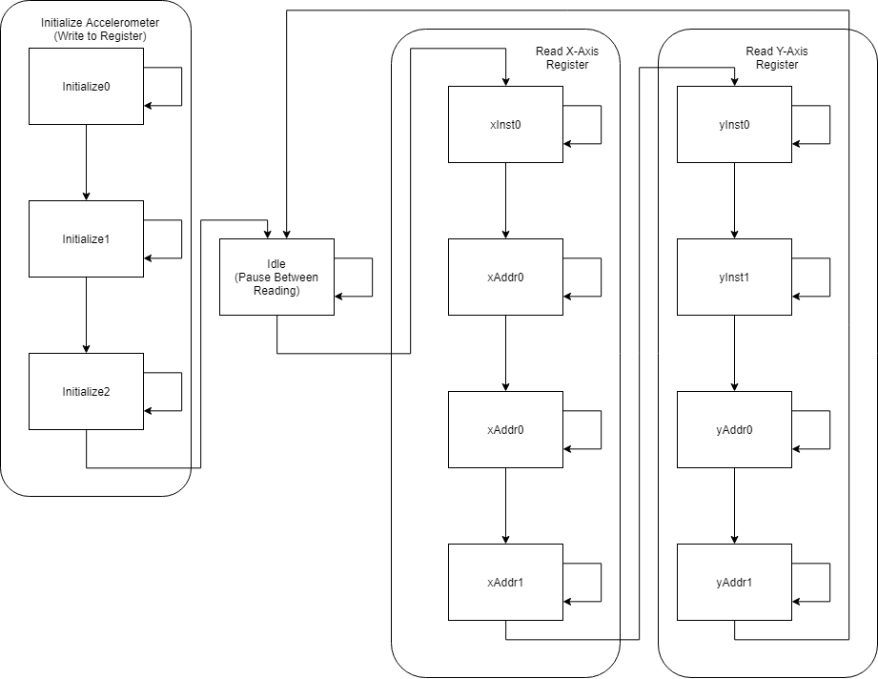
SPI Controller FSM

